Slide 1
CSE419 – Artificial Intelligence and Machine Learning 2018 PhD Furkan Gözükara, Toros University https://github.com/FurkanGozukara/CSE419_2018
Lecture 11
Large Margin Classifiers
Based on Asst. Prof. Dr. David Kauchak (Pomona College) Lecture Slides

Slide 2
Which hyperplane?
Two main variations in linear classifiers:
which hyperplane they choose when the data is linearly separable
how they handle data that is not linearly separable

Slide 3
Linear approaches so far
Perceptron:
separable:
non-separable:
Gradient descent:
separable:
non-separable:

Slide 4
Linear approaches so far
Perceptron:
separable:
finds some hyperplane that separates the data
non-separable:
will continue to adjust as it iterates through the examples
final hyperplane will depend on which examples is saw recently
Gradient descent:
separable and non-separable
finds the hyperplane that minimizes the objective function (loss + regularization)
Which hyperplane is this?

Slide 5
Which hyperplane would you choose?

Slide 6
Large margin classifiers
margin
margin
Choose the line where the distance to the nearest point(s) is as large as possible

Slide 7
Large margin classifiers
margin
margin
The margin of a classifier is the distance to the closest points of either class
Large margin classifiers attempt to maximize this

Slide 8
Large margin classifier setup
Select the hyperplane with the largest margin where the points are classified correctly!
Setup as a constrained optimization problem:
subject to:
what does this say?

Slide 9
Large margin classifier setup
subject to:
subject to:
Are these equivalent?

Slide 10
Large margin classifier setup
subject to:
subject to:
w=(0.5,1)
w=1,2)
w=(2,4)
…
Notes:
- we can always scale w by a constant factor

Slide 11
Large margin classifier setup
subject to:
We’ll assume c =1, however, any c > 0 works
Notes:
- we can always scale w by a constant factor

Slide 12
Measuring the margin
How do we calculate the margin?

Slide 13
Support vectors
For any separating hyperplane, there exist some set of “closest points”
These are called the support vectors
Notes:
- they are vectors (i.e. points) and they support/define the line

Slide 14
Measuring the margin
The margin is the distance to the support vectors, i.e. the “closest points”, on either side of the hyperplane

Slide 15
Distance from the hyperplane
How far away is this point from the hyperplane?
f₂
w=(1,2)
f₁
(-1,-2)

Slide 16
Distance from the hyperplane
How far away is this point from the hyperplane?
f₂
w=(1,2)
f₁
(-1,-2)

Slide 17
Distance from the hyperplane
How far away is this point from the hyperplane?
f₂
w=(1,2)
(1,1)
f₁

Slide 18
Distance from the hyperplane
How far away is this point from the hyperplane?
f₂
w=(1,2)
(1,1)
f₁
length normalized weight vectors

Slide 19
Distance from the hyperplane
How far away is this point from the hyperplane?
f₂
w=(1,2)
(1,1)
f₁

Slide 20
Distance from the hyperplane
Why length normalized?
f₂
w=(1,2)
(1,1)
f₁
length normalized weight vectors

Slide 21
Distance from the hyperplane
Why length normalized?
f₂
w=(2,4)
(1,1)
f₁
length normalized weight vectors

Slide 22
Distance from the hyperplane
Why length normalized?
f₂
w=(0.5,1)
(1,1)
f₁
length normalized weight vectors

Slide 23
Measuring the margin
Thought experiment:
margin
Someone gives you the optimal support vectors
Where is the max margin hyperplane?

Slide 24
Measuring the margin
Margin = (d⁺-d⁻)/2
margin
Max margin hyperplane is halfway in between the positive support vectors and the negative support vectors
Why?

Slide 25
Measuring the margin
Margin = (d⁺-d⁻)/2
margin
Max margin hyperplane is halfway in between the positive support vectors and the negative support vectors
All support vectors are the same distance
To maximize, hyperplane should be directly in between

Slide 26
Measuring the margin
Margin = (d⁺-d⁻)/2
What is wx+b for support vectors?
Hint:
subject to:

Slide 27
Measuring the margin
subject to:
The support vectors have
Otherwise, we could make the margin larger!

Slide 28
Measuring the margin
Margin = (d⁺-d⁻)/2
negative example

Slide 29
Maximizing the margin
subject to:
Maximizing the margin is equivalent to minimizing ||w||!
(subject to the separating constraints)

Slide 30
Maximizing the margin
subject to:
Maximizing the margin is equivalent to minimizing ||w||!
(subject to the separating constraints)

Slide 31
Maximizing the margin
The minimization criterion wants w to be as small as possible
subject to:
The constraints:
make sure the data is separable
encourages w to be larger (once the data is separable)

Slide 32
Maximizing the margin: the real problem
subject to:
Why the squared?

Slide 33
Maximizing the margin: the real problem
subject to:
subject to:
Minimizing ||w|| is equivalent to minimizing ||w||²
The sum of the squared weights is a convex function!

Slide 34
Support vector machine problem
subject to:
This is a version of a quadratic optimization problem
Maximize/minimize a quadratic function
Subject to a set of linear constraints
Many, many variants of solving this problem (we’ll see one in a bit)

Slide 35
CSE419 – Artificial Intelligence and Machine Learning 2018 PhD Furkan Gözükara, Toros University https://github.com/FurkanGozukara/CSE419_2018
Lecture 11.2
Soft Margin Classifiers
Based on Asst. Prof. Dr. David Kauchak (Pomona College) Lecture Slides

Slide 36
Soft Margin Classification
subject to:
What about this problem?

Slide 37
Soft Margin Classification
subject to:
We’d like to learn something like this, but our constraints won’t allow it ☹

Slide 38
Slack variables
subject to:
slack variables (one for each example)
subject to:
What effect does this have?

Slide 39
Slack variables
subject to:
slack penalties

Slide 40
Slack variables
trade-off between margin maximization and penalization
margin
penalized by how far from “correct”
subject to:
allowed to make a mistake

Slide 41
Soft margin SVM
subject to:
Still a quadratic optimization problem!

Slide 42
Demo
http://cs.stanford.edu/people/karpathy/svmjs/demo/

Slide 43
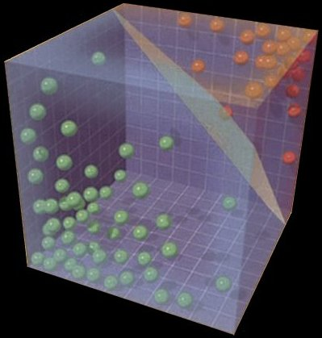
Solving the SVM problem

Slide 44
Understanding the Soft Margin SVM
subject to:
Given the optimal solution, w, b:
Can we figure out what the slack penalties are for each point?

Slide 45
Understanding the Soft Margin SVM
What do the margin lines
represent wrt w,b?
subject to:

Slide 46
Understanding the Soft Margin SVM
subject to:
Or:

Slide 47
Understanding the Soft Margin SVM
subject to:
What are the slack values for points outside (or on) the margin AND correctly classified?

Slide 48
Understanding the Soft Margin SVM
subject to:
0! The slack variables have to be greater than or equal to zero and if they’re on or beyond the margin then y_{i}(wx_{i}+b) ≥ 1 already

Slide 49
Understanding the Soft Margin SVM
subject to:
What are the slack values for points inside the margin AND classified correctly?

Slide 50
Understanding the Soft Margin SVM
subject to:
Difference from point to the margin. Which is?

Slide 51
Understanding the Soft Margin SVM
subject to:
What are the slack values for points that are incorrectly classified?

Slide 52
Understanding the Soft Margin SVM
subject to:
Which is?

Slide 53
Understanding the Soft Margin SVM
subject to:
“distance” to the hyperplane plus the “distance” to the margin
?
Notes:
“distance” is the unnormalized projection, not to be confused with the true distance which would be with respect to w/||w||

Slide 54
Understanding the Soft Margin SVM
subject to:
“distance” to the hyperplane plus the “distance” to the margin
Why -?
Notes:
the points are incorrectly classified so the prediction (wx+b) times the label (yi) will have different signs

Slide 55
Understanding the Soft Margin SVM
subject to:
“distance” to the hyperplane plus the “distance” to the margin
?

Slide 56
Understanding the Soft Margin SVM
subject to:
“distance” to the hyperplane plus the “distance” to the margin
1

Slide 57
Understanding the Soft Margin SVM
subject to:
“distance” to the hyperplane plus the “distance” to the margin

Slide 58
Understanding the Soft Margin SVM
subject to:

Slide 59
Understanding the Soft Margin SVM
Does this look familiar?

Slide 60
Hinge loss!
0/1 loss:
Hinge:
Exponential:
Squared loss:

Slide 61
Understanding the Soft Margin SVM
subject to:
Do we need the constraints still?

Slide 62
Understanding the Soft Margin SVM
subject to:
Unconstrained problem!

Slide 63
Understanding the Soft Margin SVM
Does this look like something we’ve seen before?
Gradient descent problem!

Slide 64
Soft margin SVM as gradient descent
multiply through by 1/C
and rearrange
let λ=1/C
What type of gradient descent problem?

Slide 65
Soft margin SVM as gradient descent
One way to solve the soft margin SVM problem is using gradient descent
hinge loss
L2 regularization

Slide 66
Gradient descent SVM solver
pick a starting point (w)
repeat until loss doesn’t decrease in all dimensions:
pick a dimension
move a small amount in that dimension towards decreasing loss (using the derivative)
hinge loss
L2 regularization
Finds the largest margin hyperplane while allowing for a soft margin

Slide 67





Support vector machines
One of the most successful (if not the most successful) classification approach:
decision tree
Support vector machine
k nearest neighbor
perceptron algorithm

Slide 68
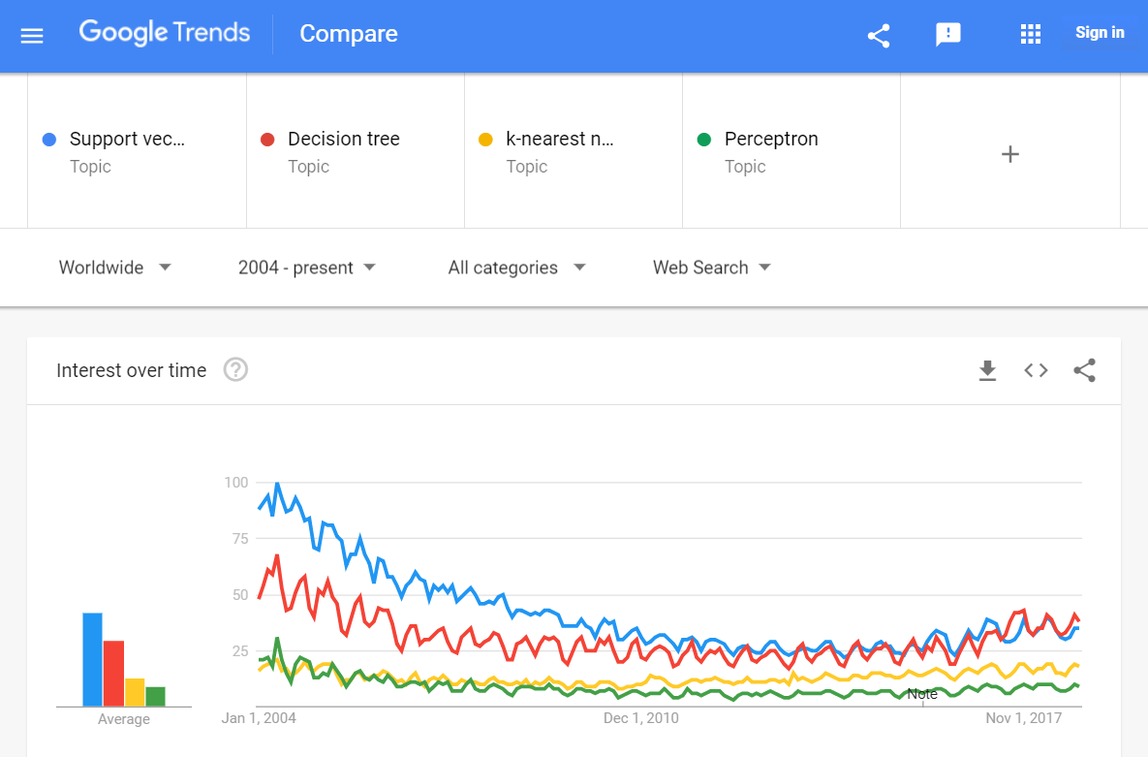
Trends over time

